Slide 1


Visualizing Data in R using ggplot2
Lauren Nichols
Lmn7@duke.edu
Data Visualization Specialist

Slide 2



Data Visualization Specialists
Lauren Nichols
McCall Pitcher
Eric Monson

Slide 3
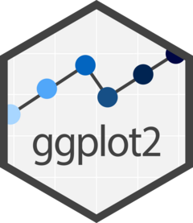

Slide 4
Data
Aesthetics
Geometries
Statistics
“gg” in ggplot2 stands for “Grammar of Graphics”
Graphics are built by layering elements
Scales
Themes
Notes:
(move it over)

Slide 5
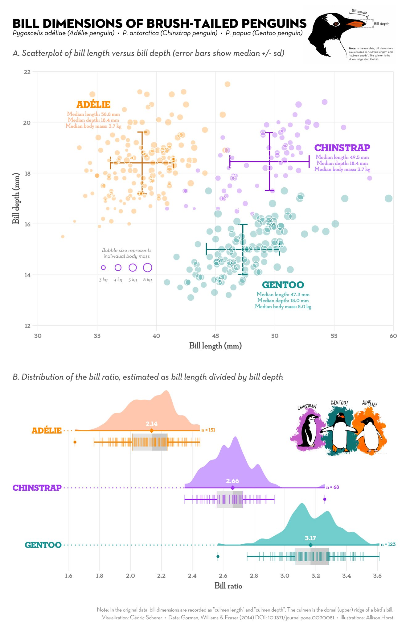
Notes:
Integration with analysis in R
Succinct
Versatile
Publication ready graphics
(or at least pretty close to it)

Slide 6
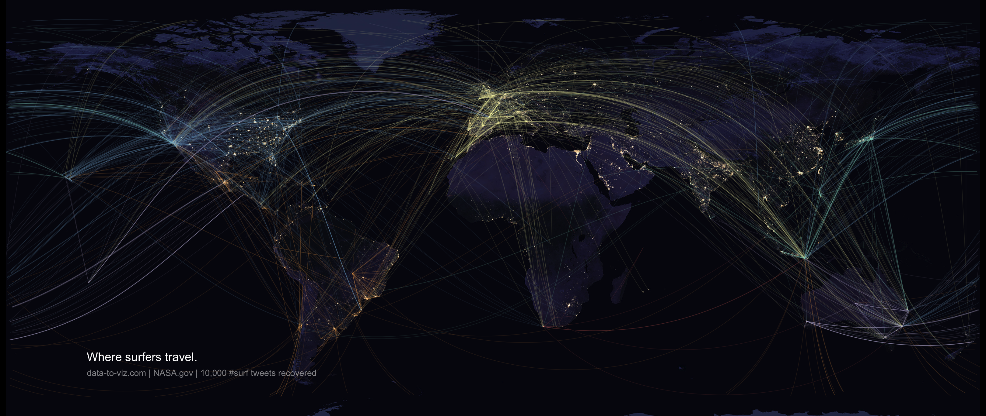
Notes:
Bespoke figures

Slide 7
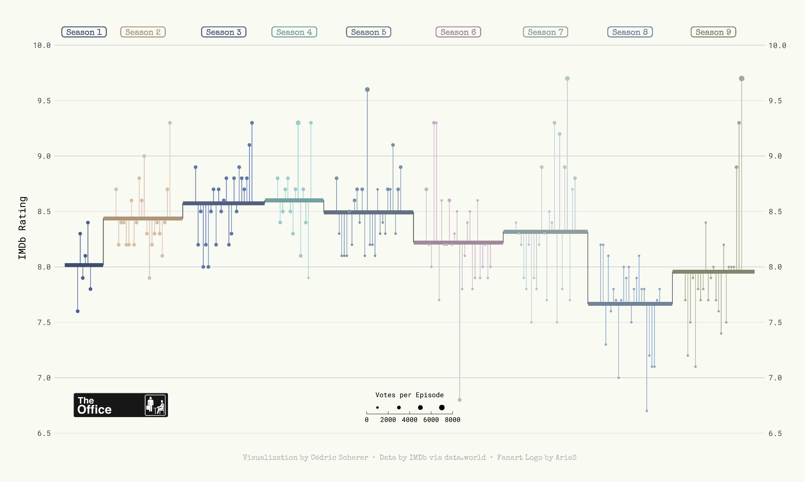

Slide 8
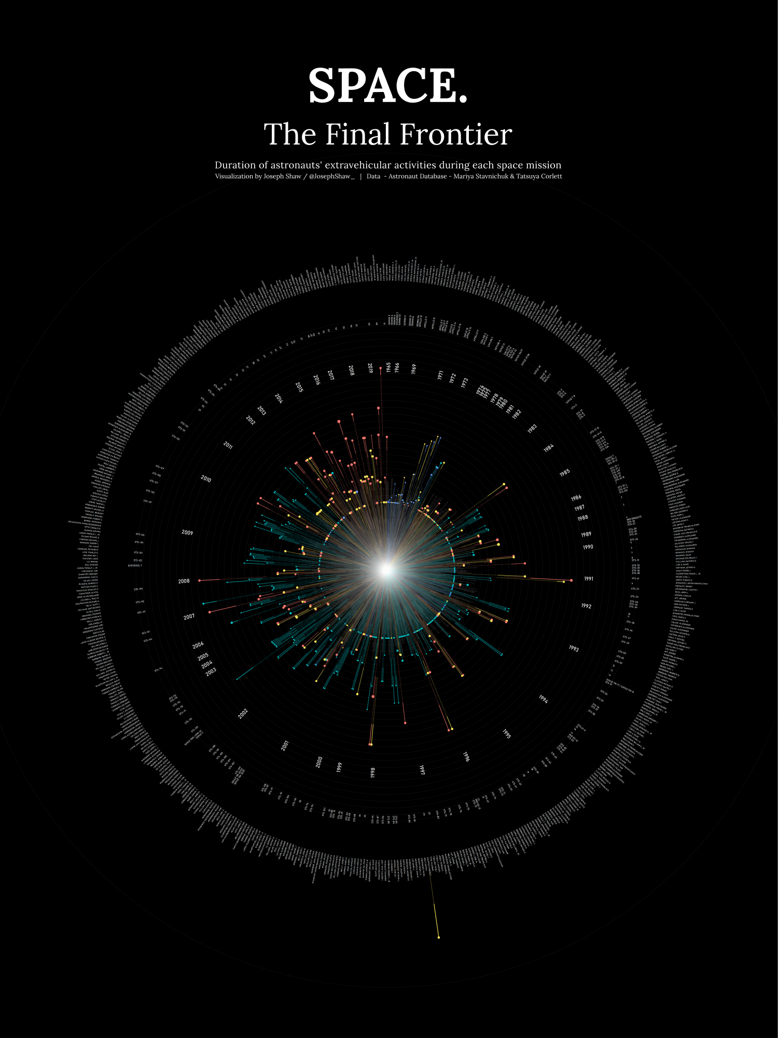
github.com/joseph-shaw/tidytuesday/

Slide 9
github.com/joseph-shaw/tidytuesday/

Slide 10
Data
ggplot(
data = yourdata
,
Mapping
mapping = aes(x axis, y axis)
) +
geometry function
+
Geometries
statistics function
+
Statistics
scales function
+
themes function
Scales
Themes
Notes:
method chaining with a +

Slide 11
Data
ggplot(
data = yourdata
,
Aesthetics
mapping = aes(x axis, y axis)
) +
geometry function
+
Geometries
statistics function
+
Statistics
scales function
+
themes function
Scales
Themes
Notes:
method chaining with a +

Slide 12
Data Format
Wide data
Long data (aka. Tidy data)
animal | female | male
dog | 3 | 4
cat | 3 | 1
rat | 3 | 5
animal | sex | number
dog | female | 3
cat | female | 3
rat | female | 3
dog | male | 4
cat | male | 1
rat | male | 5

Slide 13
Data Format
Wide data
Long data (aka. Tidy data)
animal | female | male
dog | 3 | 4
cat | 3 | 1
rat | 3 | 5
animal | sex | number
dog | female | 3
cat | female | 3
rat | female | 3
dog | male | 4
cat | male | 1
rat | male | 5
fx

Slide 14
Data Format
Wide data
Long data (aka. Tidy data)
animal | female | male
dog | 3 | 4
cat | 3 | 1
rat | 3 | 5
animal | sex | number
dog | female | 3
cat | female | 3
rat | female | 3
dog | male | 4
cat | male | 1
rat | male | 5
fx
fx
wide_data |>
pivot_long(names_to = “sex”, values_to = “number”)
fx
fx

Slide 15
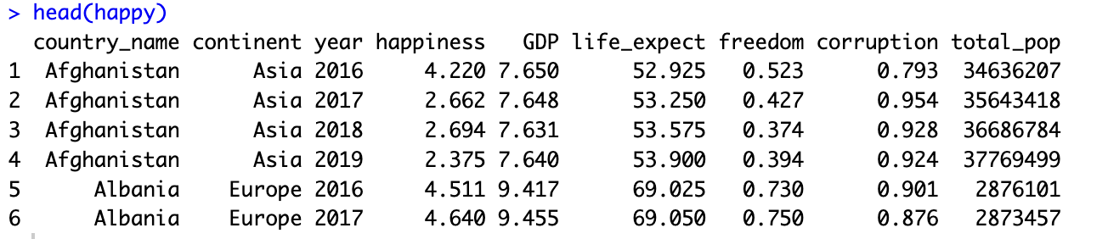

Slide 17
ggplot(data = ,
mapping = aes(x= , ,y= ))+
your data
x axis
y axis
Data
geometry function
Aesthetics
Geometries
Statistics
Facets
Themes
Exporting
Notes:
method chaining with a +

Slide 18
ggplot(data = ,
mapping = aes(x= , ,y= ))+
your data
x axis
y axis
Data
geometry function
Aesthetics
Geometries
Statistics
ggplot(data = ,
mapping = aes(x= , ,y= ))+
happy
happiness
GDP
Facets
geom_point()
Themes
Exporting
Notes:
method chaining with a +

Slide 19
ggplot(data = ,
mapping = aes(x= , ,y= ))+
your data
x axis
y axis
Data
geometry function
Aesthetics
Geometries
Statistics
ggplot(data = ,
mapping = aes(x= , ,y= ))+
happy
happiness
GDP
Facets
geom_point()
Themes
Exporting
Notes:
method chaining with a +

Slide 20
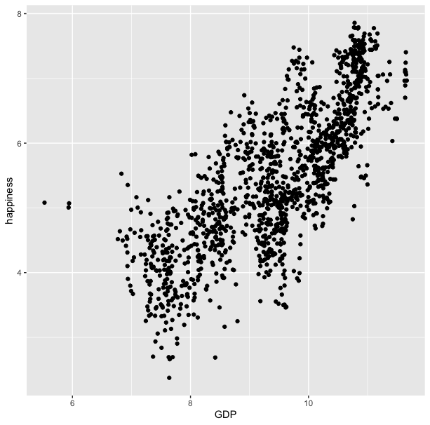
ggplot(data = happy, aes(x=GDP, y=happiness))+
geom_point()

Slide 21
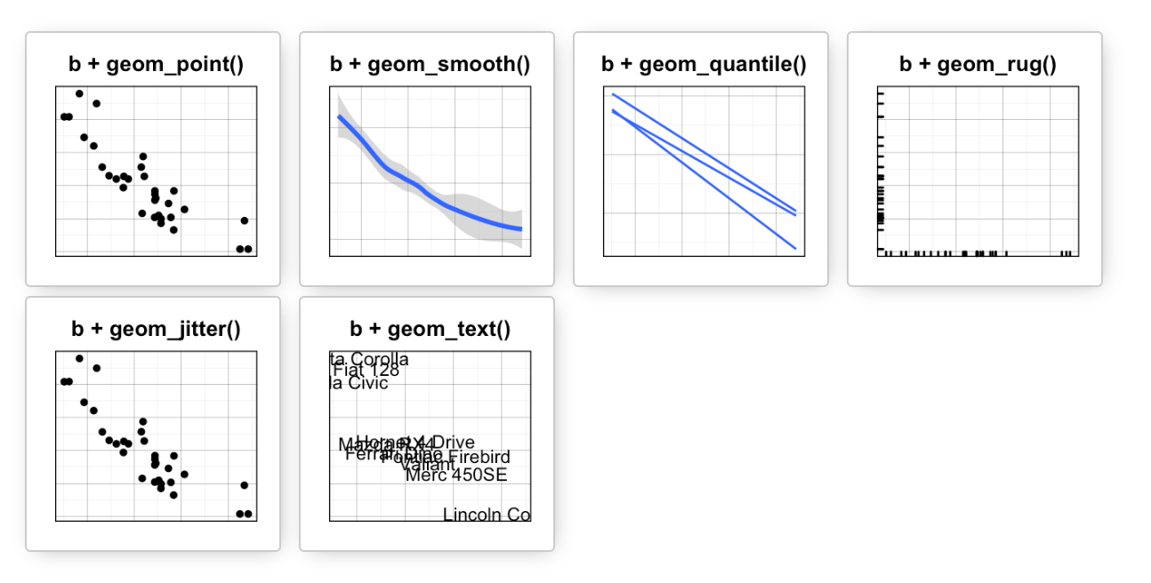
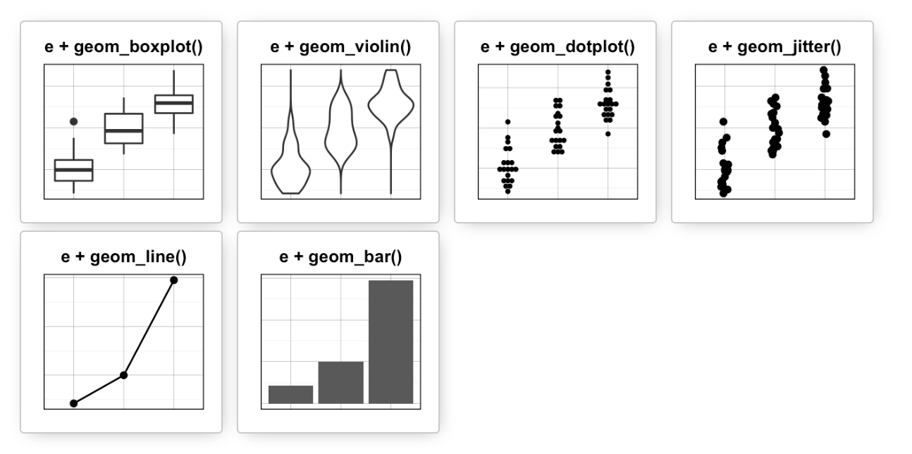
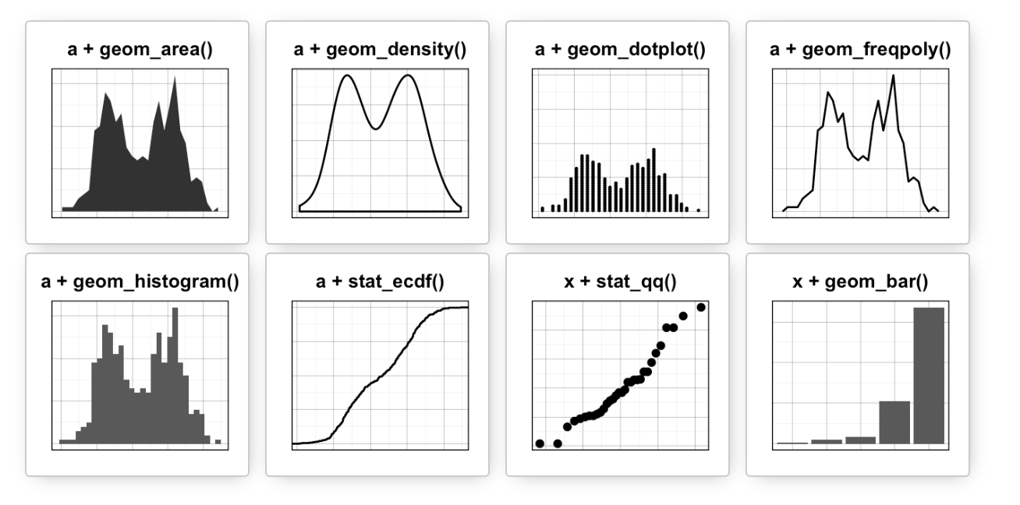
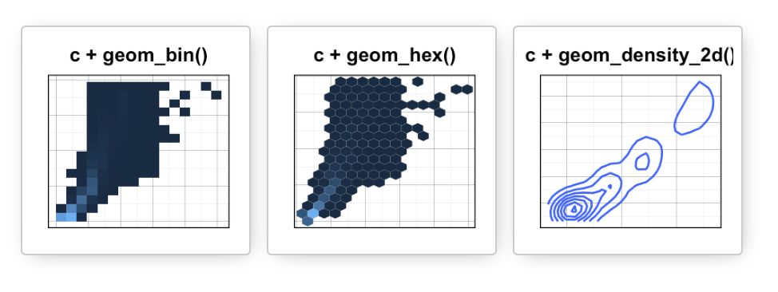
Data
Aesthetics
Geometries
Statistics
Facets
Themes
Exporting
Notes:
MOVE UP before showing plot

Slide 22
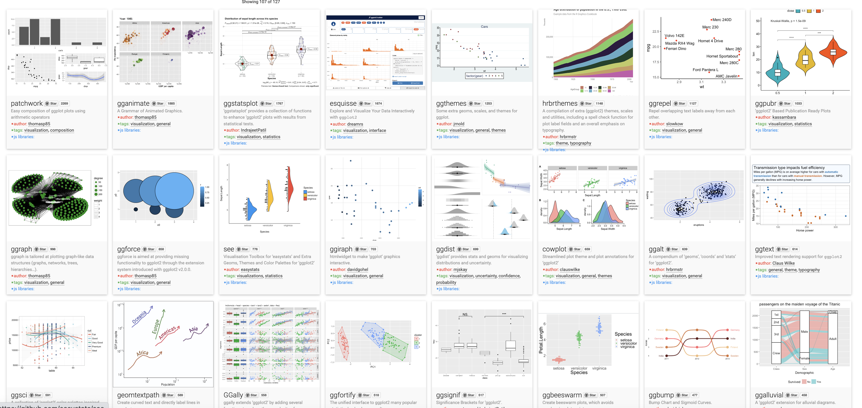
Over 120 ggplot2 extension libraries

Slide 23
ggplot(data = happy, aes(x=GDP, y=happiness))+
geom_point()
“and then…”
dplyr %>% or |>
ggplot +
Notes:
chaining method
Similar to the pipes in dplyr

Slide 24
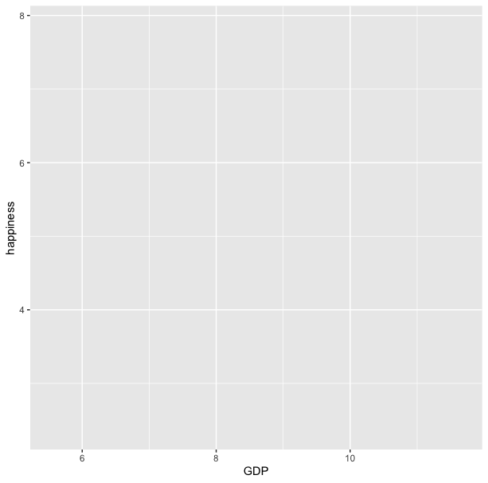
ggplot(data = happy, aes(x=GDP, y=happiness))

Slide 25
ggplot(data = happy, aes(x=GDP, y=happiness))+
geom_point()

Slide 26
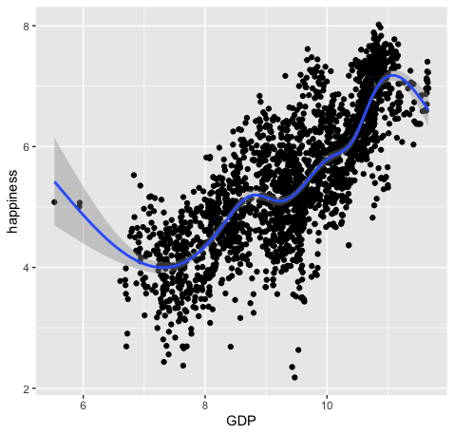
ggplot(data = happy, aes(x=GDP, y=happiness))+
geom_point()+
geom_smooth()

Slide 27
ggplot(data = happy,
mapping = aes(x=GDP, y=happiness))+
geom_point()

Slide 28
ggplot(data = happy,
mapping = aes(x=GDP, y=happiness))+
geom_point()
ggplot(happy, aes(GDP, happiness))+
geom_point()

Slide 29
ggplot(data = happy,
mapping = aes(x=GDP, y=happiness))+
geom_point()
ggplot(happy, aes(GDP, happiness))+
geom_point()
ggplot()+
geom_point(happy,aes(GDP,happiness))

Slide 30
ggplot(data = happy,
mapping = aes(x=GDP, y=happiness))+
geom_point()
ggplot(happy, aes(GDP, happiness))+
geom_point()
ggplot()+
geom_point(happy,aes(GDP,happiness))
happy %>%
ggplot(aes(GDP,happiness))+
geom_point()

Slide 31
ggplot(data = happy,
mapping = aes(x=GDP, y=happiness))+
geom_point()
ggplot(happy, aes(GDP, happiness))+
geom_point()
ggplot()+
geom_point(happy,aes(GDP,happiness))
happy %>%
ggplot(aes(GDP,happiness))+
geom_point()
These all produce the same figure!

Slide 32
Aesthetics define any data that gets mapped to geometry
(such as color, size, shape, etc.)
Data
Aesthetics
Geometries
Statistics
ggplot(data = yourData,
aes(x = xaxis,y = yaxis))+
geom_point()
Facets
Themes
Exporting
Notes:
method chaining with a +

Slide 33
Aesthetics define any data that gets mapped to geometry
(such as color, size, shape, etc.)
Data
Aesthetics
Geometries
Statistics
ggplot(data = happy,
aes(x = happiness,y = GDP))+
geom_point()
ggplot(data = yourData,
mapping = aes(x = xaxis,y = yaxis))+
geom_point()
Facets
Themes
Exporting
Notes:
REMOVE THIS SLIDE

Slide 35
ggplot(happy, aes(GDP, happiness)) +
geom_point()

Slide 36
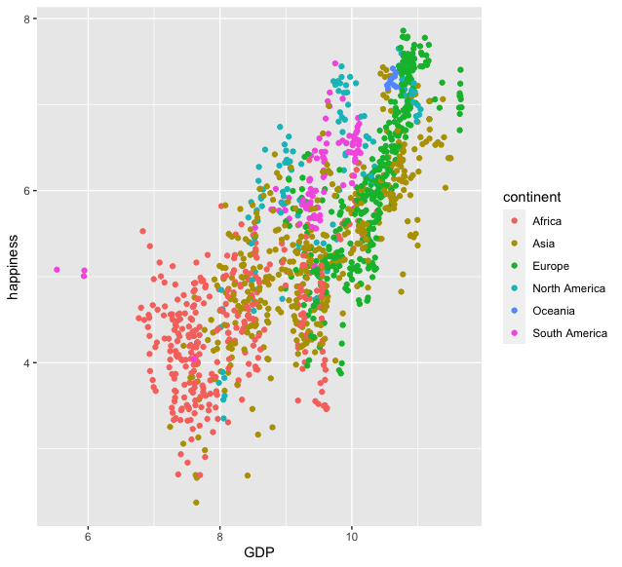
ggplot(happy, aes(GDP, happiness)) +
geom_point(aes(col=continent))

Slide 37
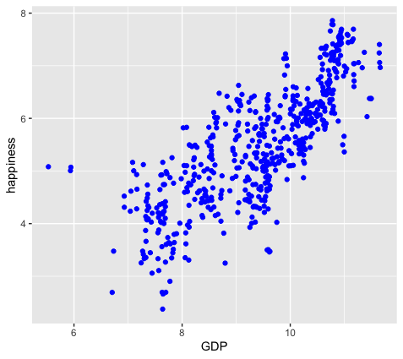
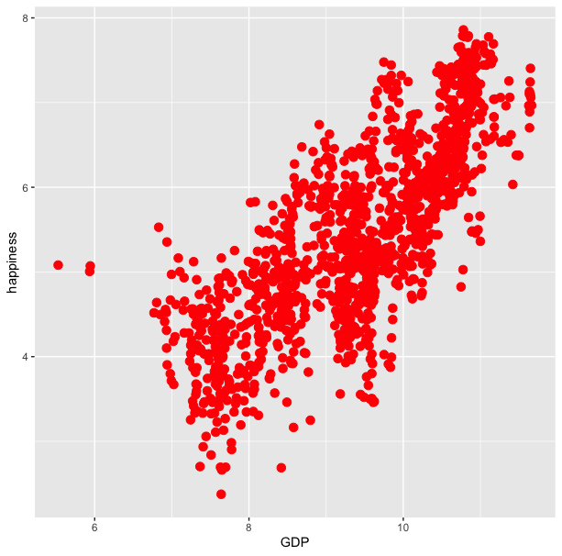
ggplot(happy, aes(GDP, happiness)) +
geom_point(aes(col=continent))
ggplot(happy, aes(GDP, happiness)) +
geom_point(col=‘blue’)

Slide 38
ggplot(happy, aes(GDP, happiness)) +
geom_point(aes(col=continent))
ggplot(happy, aes(GDP, happiness)) +
geom_point(col=‘blue’)
ggplot(happy, aes(GDP, happiness)) +
geom_point(aes(col=‘blue’))

Slide 39
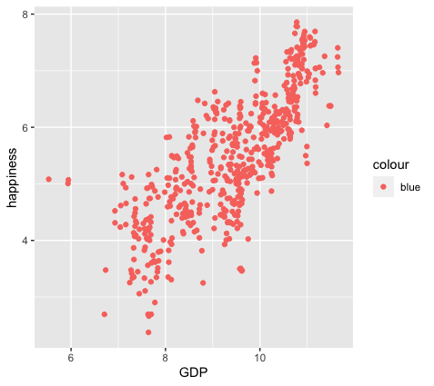
ggplot(happy, aes(GDP, happiness)) +
geom_point(aes(col=continent))
ggplot(happy, aes(GDP, happiness)) +
geom_point(col=‘blue’)
ggplot(happy, aes(GDP, happiness)) +
geom_point(aes(col=‘blue’))

Slide 40
colour
blue
blue
blue
blue
blue
blue
ggplot(happy, aes(GDP, happiness)) +
geom_point(aes(col=‘blue’))

Slide 41
ggplot(happy, aes(GDP, happiness)) +
geom_point()
We can also set conditional formatting.
e.g. Use different colors for points where happiness is > 5

Slide 42
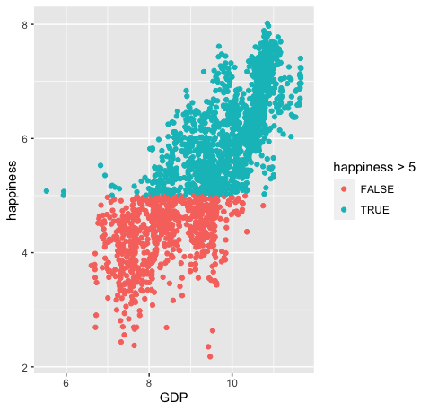
ggplot(happy, aes(GDP, happiness)) +
geom_point()
ggplot(happy, aes(GDP, happiness)) +
geom_point(aes(col=happiness > 5)

Slide 43
Data
ggplot(
data = yourdata
,
Mapping
mapping = aes(x axis, y axis)
) +
geometry function
+
Geometries
statistics function
+
Statistics
scales function
+
themes function
Scales
Themes
Notes:
method chaining with a +

Slide 44
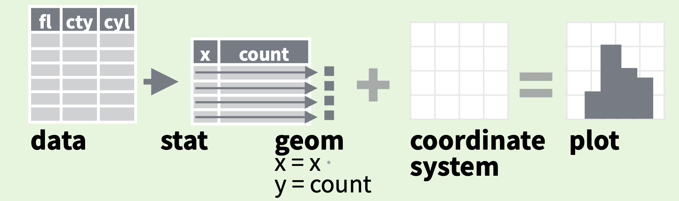
Data
Aesthetics
Geometries
Statistics
Facets
Themes
Exporting

Slide 45
Every geom function specifies a stat
Use a stat function (calls a default geom to make a layer)
Data
Aesthetics
Geometries
Statistics
Facets
Themes
Exporting

Slide 46
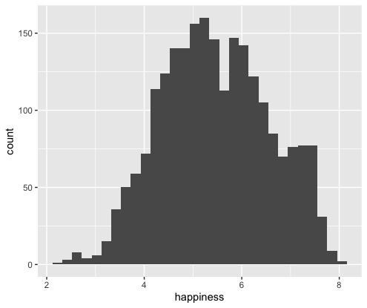
Every geom function specifies a stat
Use a stat function
(calls a default geom to make a layer)
ggplot(happy, aes(happiness)) +
geom_histogram()

Slide 47
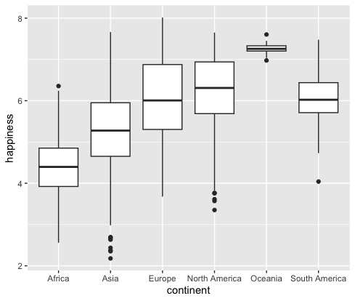
Every geom function specifies a stat
Use a stat function
(calls a default geom to make a layer)
ggplot(happy, aes(continent, happiness)) +
geom_boxplot()

Slide 48
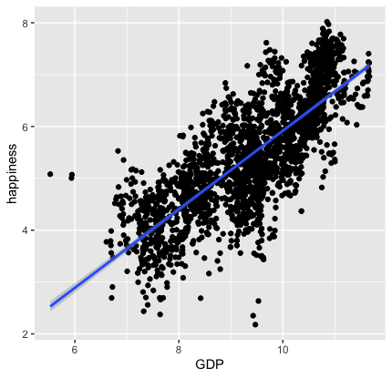
Every geom function specifies a stat
Use a stat function
(calls a default geom to make a layer)
ggplot(happy, aes(GDP, happiness)) +
geom_point()+
stat_smooth(method = "lm",
formula = y ~ x)

Slide 49
Data
Aesthetics
Geometries
Statistics
Facets
Themes
Exporting

Slide 50
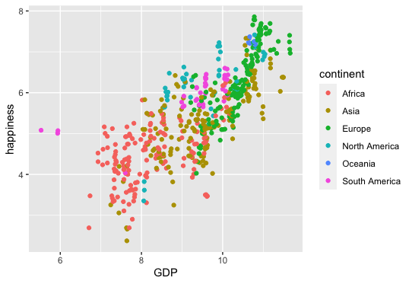
ggplot(happy, aes(GDP, happiness))+
geom_point(aes(col=continent))

Slide 51
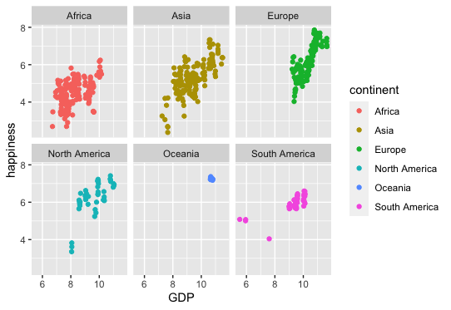
ggplot(happy, aes(GDP, happiness))+
geom_point(aes(col=continent))
ggplot(happy, aes(GDP, happiness))+
geom_point(aes(col=continent))+
facet_wrap(~continent)

Slide 52
ggplot(happy, aes(GDP, happiness))+
geom_point(aes(col=continent))
ggplot(happy, aes(GDP, happiness))+
geom_point(aes(col=continent))+
facet_wrap(~continent)

Slide 53
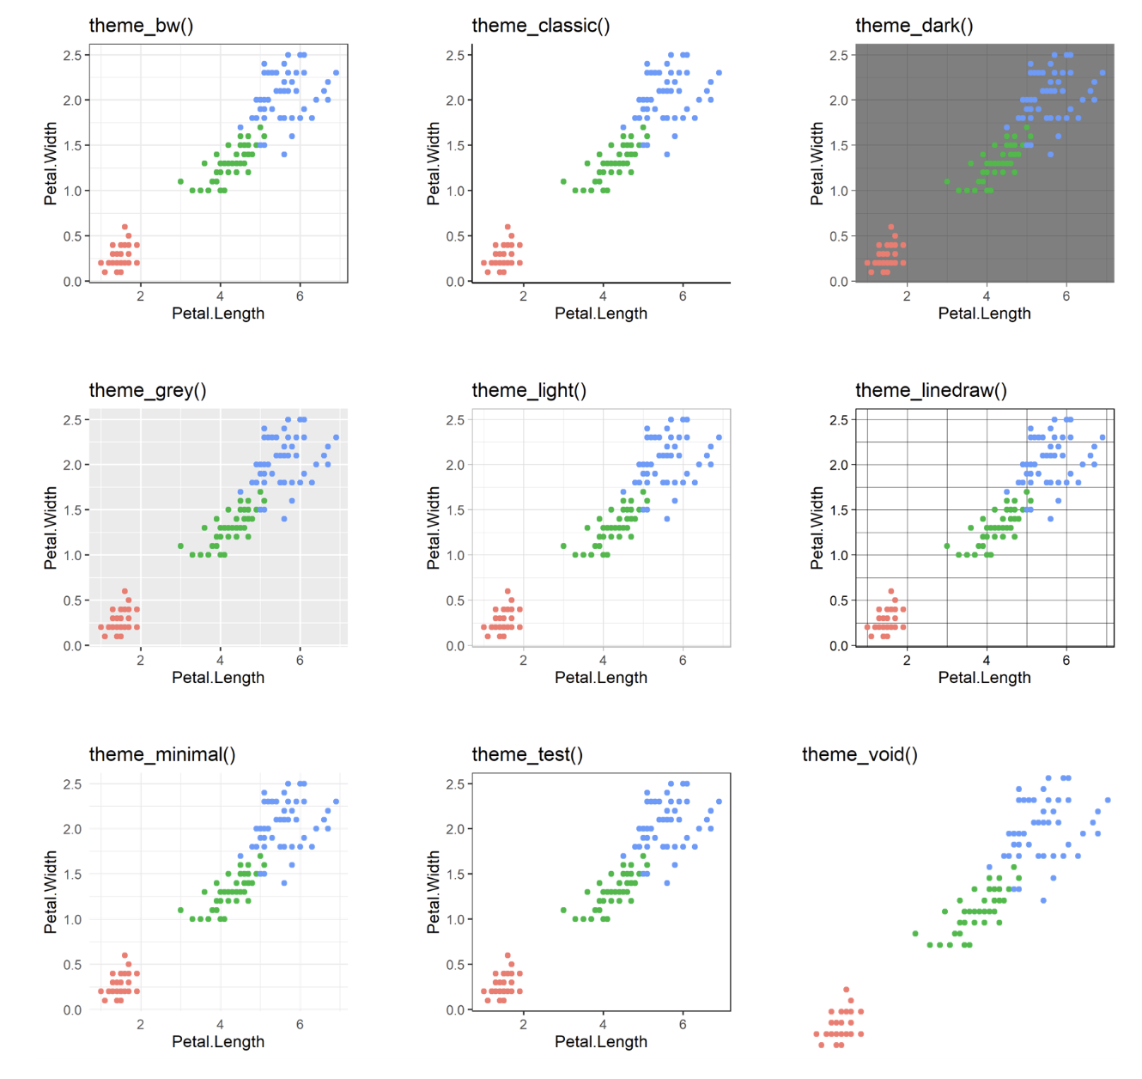
60 preexisting themes
easy to call
Data
Aesthetics
Geometries
Statistics
Facets
Themes & scales
Exporting

Slide 54
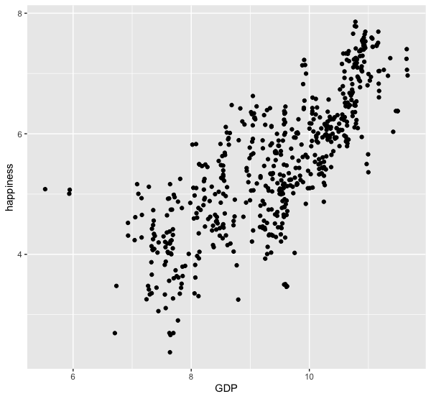
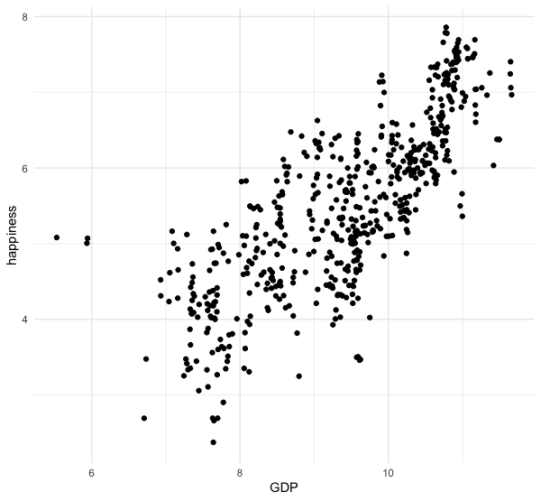
ggplot(happy, aes(GDP, happiness))+
geom_point()
ggplot(happy, aes(GDP, happiness))+
geom_point()+
theme_minimal()

Slide 55
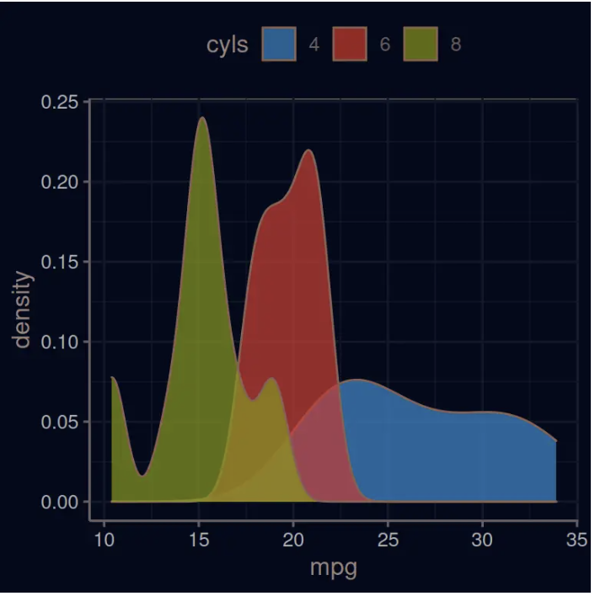
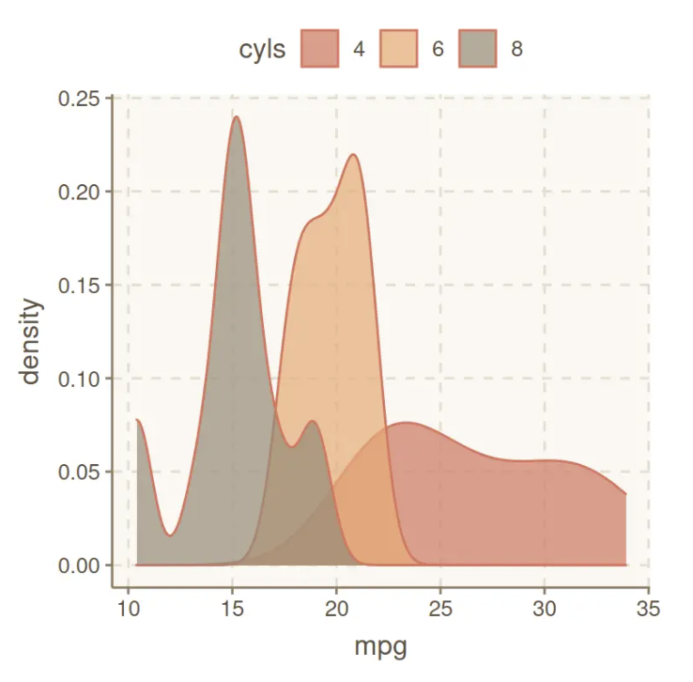
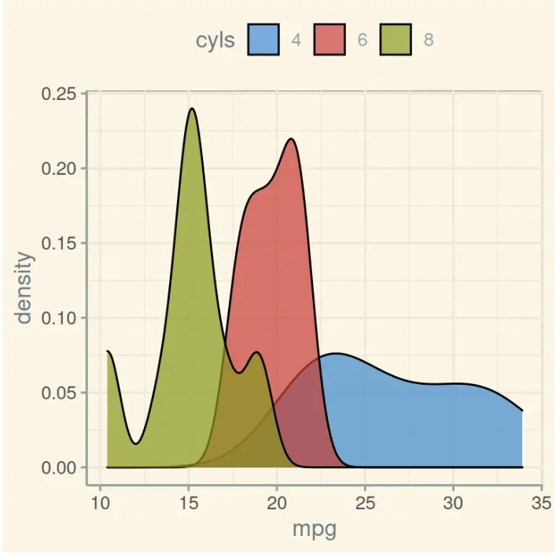
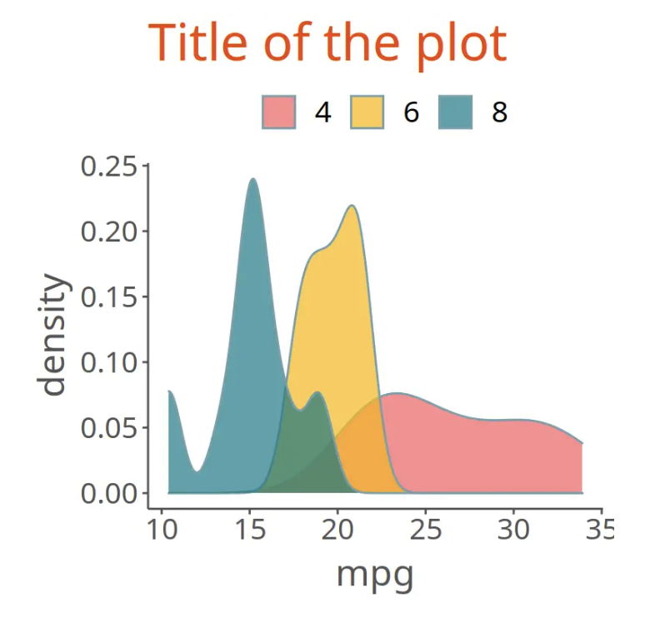
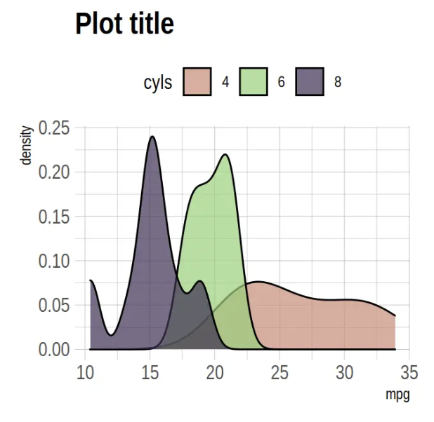
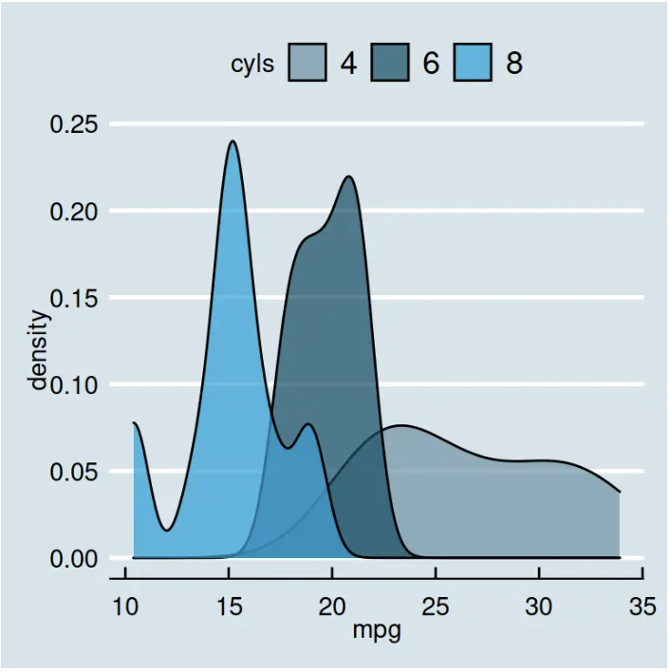
Over 60 pre-existing themes
Data
Aesthetics
Geometries
Statistics
Facets
Themes & scales
Exporting
https://r-charts.com/ggplot2/themes/

Slide 56
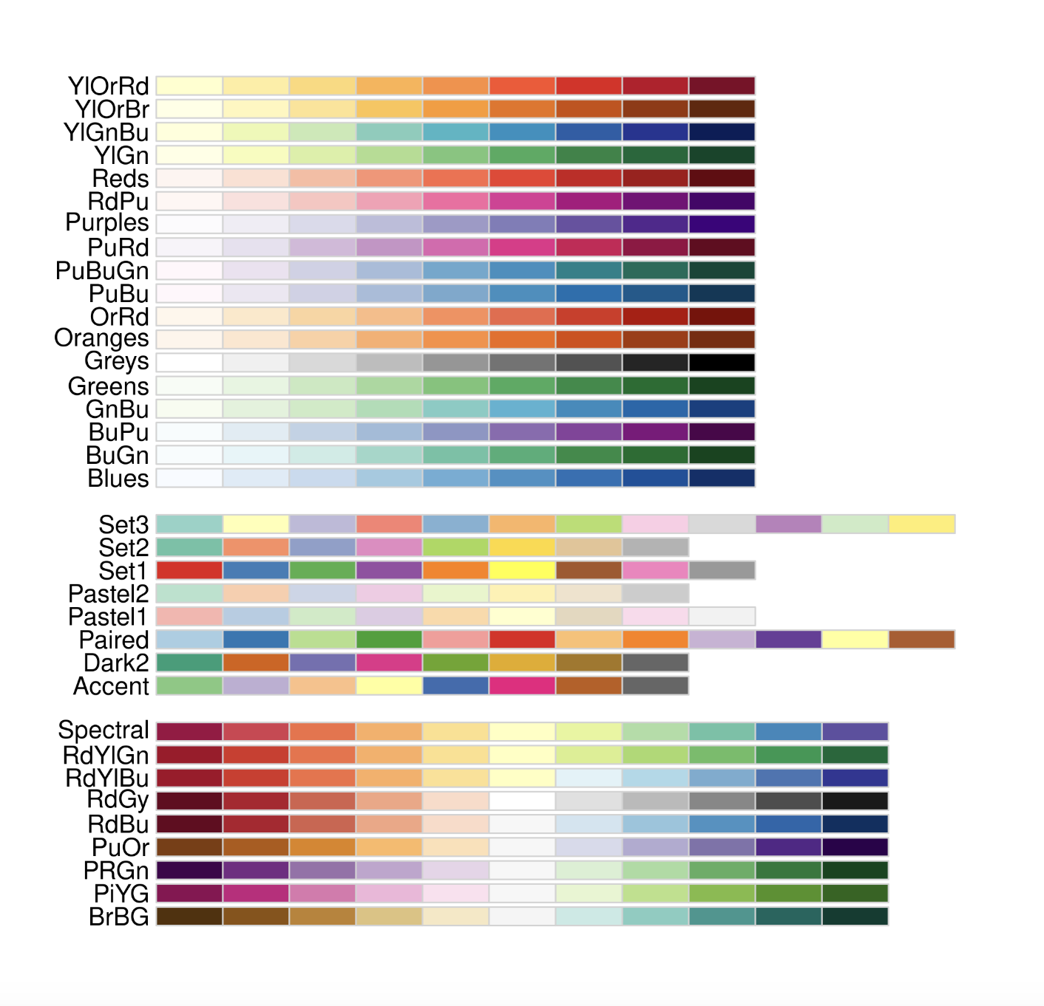
Brewer Scales
Data
Aesthetics
Geometries
Statistics
Facets
Themes & scales
Exporting

Slide 57
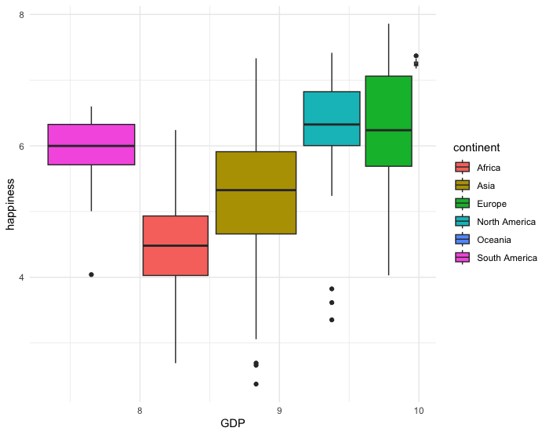
Brewer Scales
ggplot(happy, aes(GDP, happiness))+
geom_boxplot(aes(fill=continent)) +
theme_minimal

Slide 58
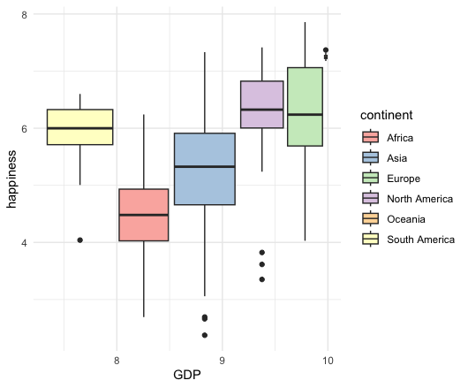
Brewer Scales
ggplot(happy, aes(GDP, happiness))+
geom_boxplot(aes(fill=continent)) +
theme_minimal()+
scale_fill_brewer(palette = "Set3")

Slide 59
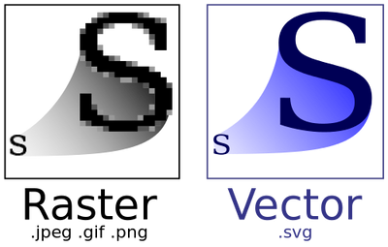
Data
Aesthetics
Geometries
Statistics
Facets
.pdf
Themes
Exporting

Slide 60
Lets give it a try

Slide 61
Strengths
Data
Integration with analysis in R
Based on Grammar of Graphics
Declarative
Succinct
Versatile
Publication ready graphics
(or at least pretty close to it)
Aesthetics
Geometries
Statistics
Facets
Themes

Slide 62
Strengths
Data
Integration with analysis in R
Based on Grammar of Graphics
Declarative
Succinct
Versatile
Publication ready graphics
(or at least pretty close to it)
Aesthetics
Geometries
Statistics
Facets
Themes

Slide 63
Strengths
Data
Integration with analysis in R
Based on Grammar of Graphics
Declarative
Succinct
Versatile
Publication ready graphics
(or at least pretty close to it)
Aesthetics
Geometries
Statistics
Facets
Themes

Slide 64
Strengths
Data
Integration with analysis in R
Based on Grammar of Graphics
Declarative
Succinct
Versatile
Publication ready graphics
(or at least pretty close to it)
Aesthetics
Geometries
Statistics
Facets
Themes

Slide 65
Strengths
Data
Integration with analysis in R
Based on Grammar of Graphics
Declarative
Succinct
Versatile
Publication ready graphics
(or at least pretty close to it)
Aesthetics
Geometries
Statistics
Facets
Themes

Slide 69
github.com/joseph-shaw/tidytuesday/

Slide 70
Strengths
Weaknesses
Integration with analysis in R
Based on Grammar of Graphics
Declarative
Succinct
Versatile
Publication ready graphics
(or at least pretty close to it)
Not practical if you’re working in another language
Interactivity not well supported

